Slide 1
Uncovering Canada's Smart City Potential
Jainil Gandhi
Nouran Nouh
Philip Mogbock
Heemel Saha

Slide 2
Business Case
Develop a tool that characterizes and identifies common features of ‘smart city early adopters’ in Canada
Assess the state of smart technology and infrastructure capacity of municipalities across Canada

Slide 3

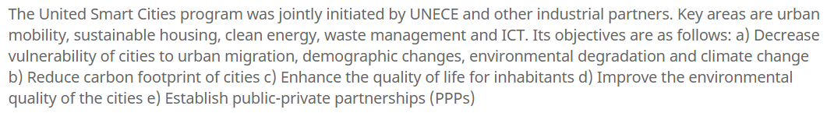
What is a Smart City?

Slide 4
Open Data
Most Common Factor amongst smart cities in Canada
2020 Citizens:
Want to be Aware, not at Cost of Time
Want Quick but Detailed Visualization

Slide 5
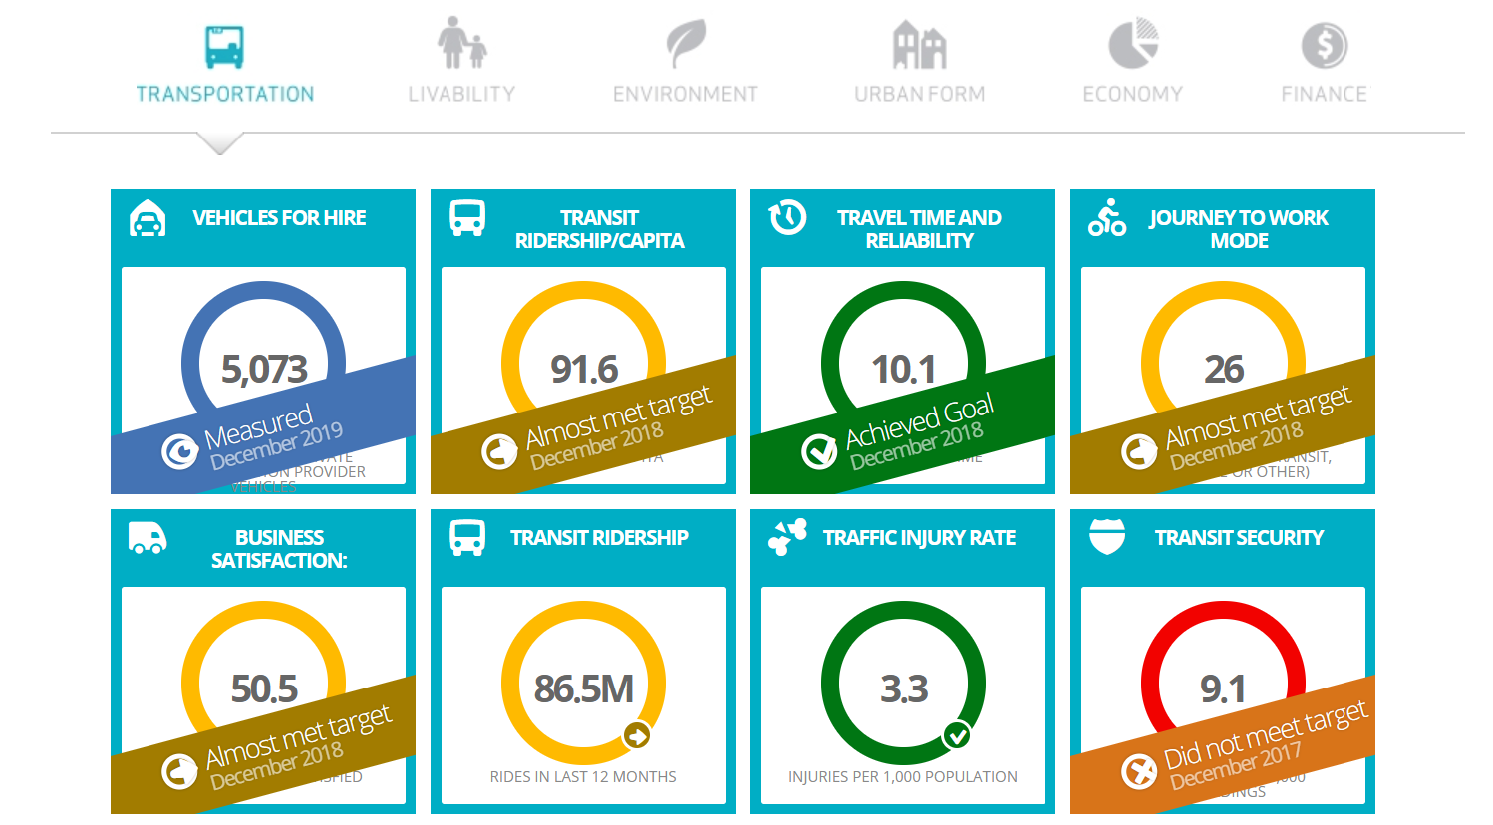
Dashboard

Slide 6
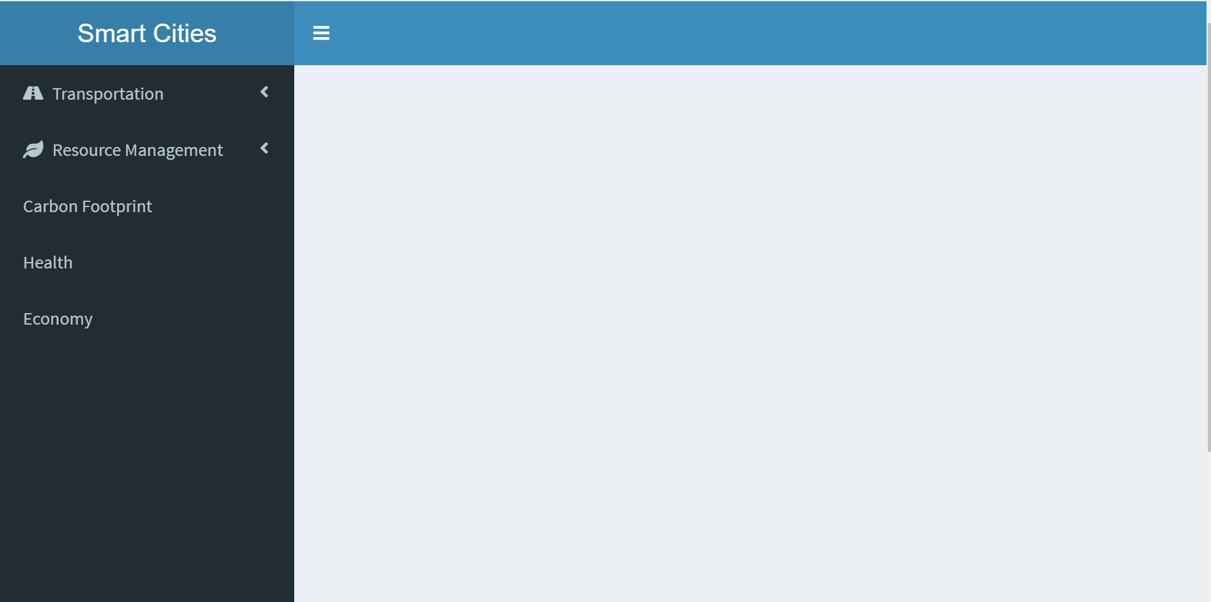

Slide 7
Standardization
Having minimum requirements met by all cities in order to be classified as a ‘smart city’
Example - Rivers and Streams within a city should maintain a pH level of 8±0.5

